Slide 1
Pixel 3 GMS App Investigations
Part 1: GMS Messaging
Notes:
https://digitalcorpora.s3.amazonaws.com/corpora/mobile/android_10/Non-Cellebrite%20Extraction/Pixel%203.zip

Slide 2
Google Mobile Services

Slide 3
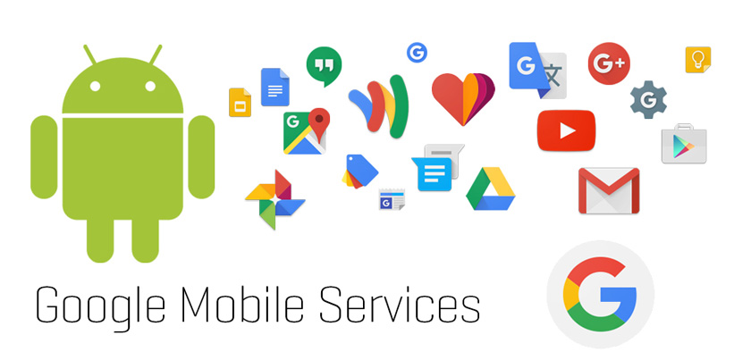
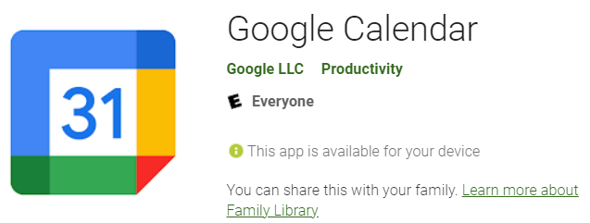
Google Mobile Services (GMS)
GMS is a collection of Google applications and APIs
Google proprietary/native application
GMS helps support functionality across devices.
These apps work together seamlessly to ensure your device provides a great user experience right out of the box.
GMS package pattern: com.google.android.calculator
Notes:
https://www.android.com/gms/

Slide 4
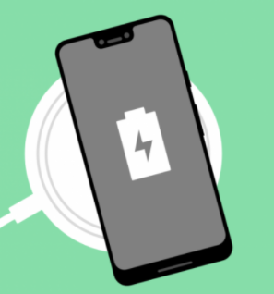
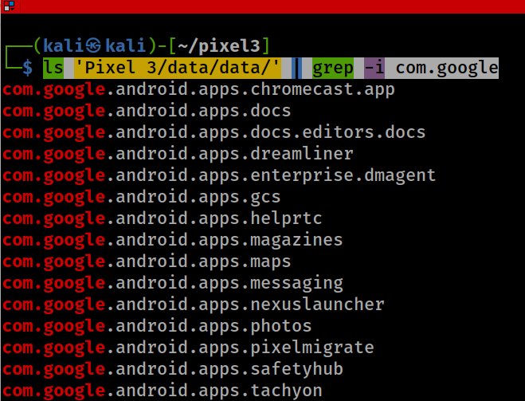
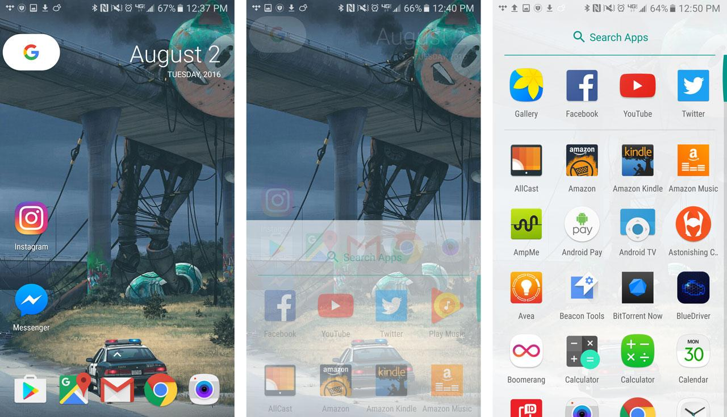
Show all Google GMS Apps: com.google.*
‘dreamliner’ wireless charging widget support
Notes:
ls 'Pixel 3/data/data/' | grep -i com.google

Slide 5
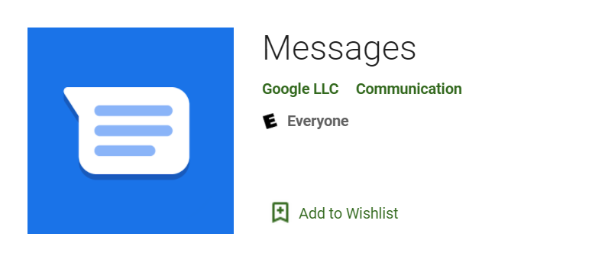

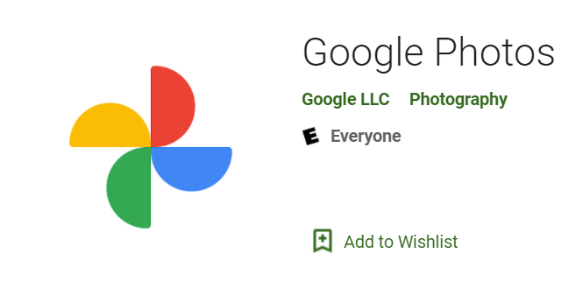
Investigating 3 GMS Apps
Investigating Google Messages
com.google.android.apps.messaging
Investigating Google Maps
com.google.android.apps.maps
Investigating Google Photos
com.google.android.apps.photos

Slide 6
Investigating Google Messages

Slide 7
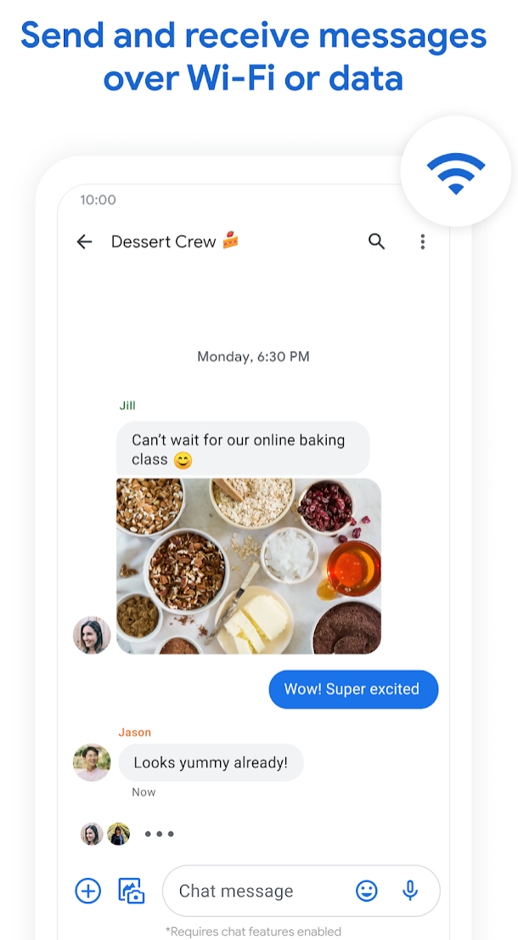
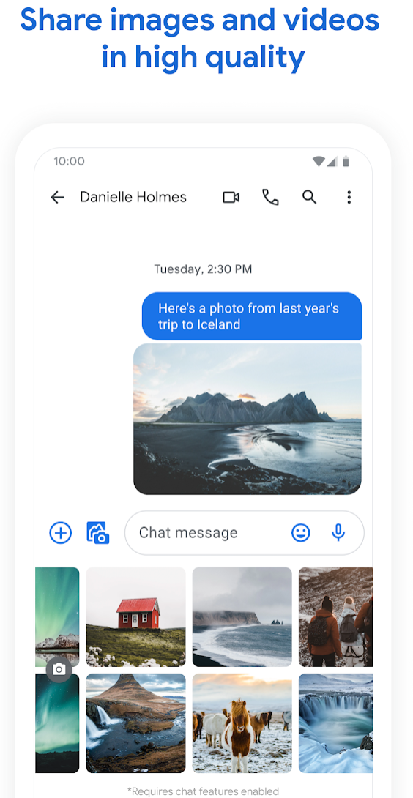
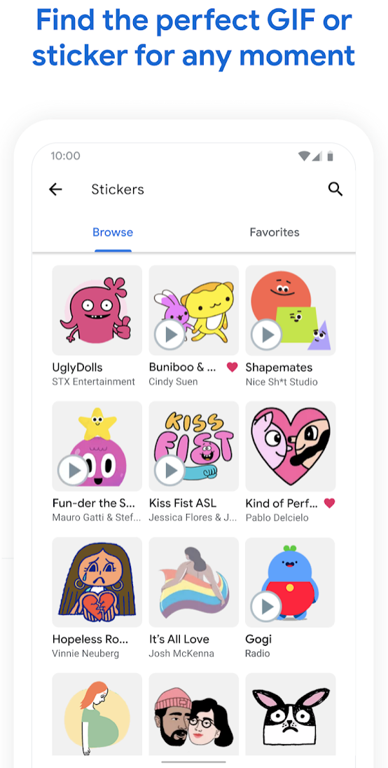
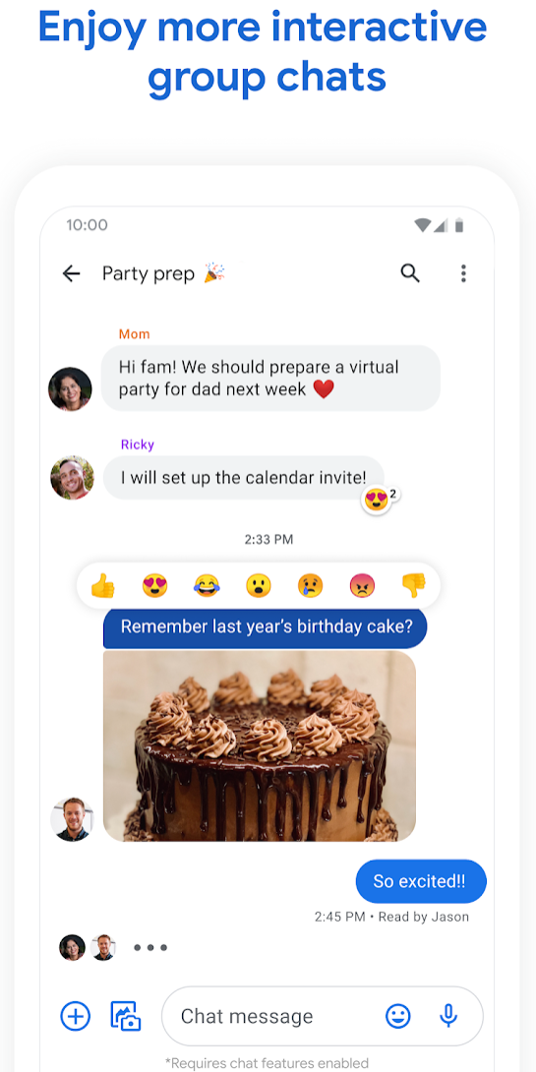
What is Google Messages?

Slide 8
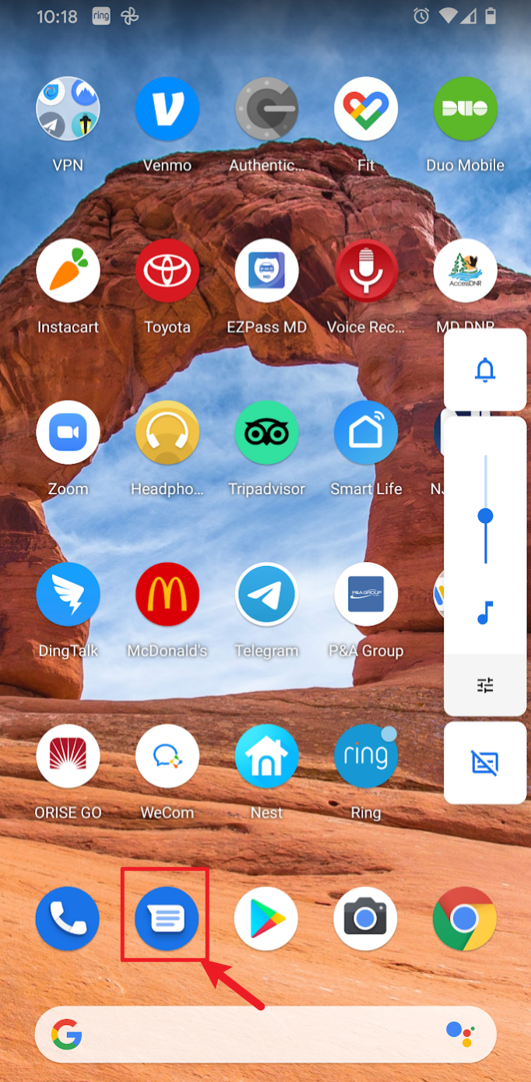
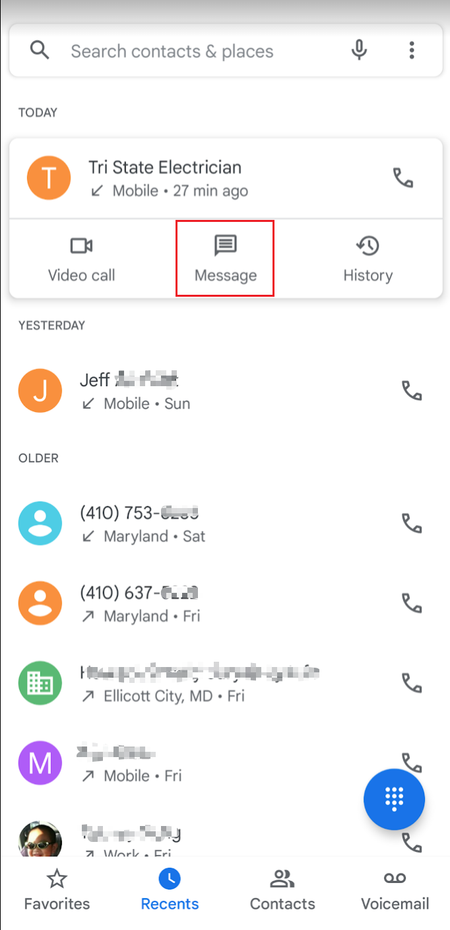
How to invoke Google Messages
Option 1
Option 2

Slide 9
Google Messages vs. AOSP messaging function of telephony service
Feature | Google Messages | AOSP Messaging
Rich Communication Services (RCS) Support | Yes | No
SMS/MMS Support | Yes | Yes
Web Interface | Yes | No
Smart Features | Yes (spam protection, suggestions) | No
End-to-End Encryption | Yes (for RCS) | No
Customization | Themes, chat bubbles | Minimal
Integration | Google Services | None
Resource Usage | Higher | Lower
Availability | Pre-installed or Play Store | Stock Android or custom ROMs
RCS: read receipts, typing indicators, high-quality media sharing, and group chats over Wi-Fi or mobile data

Slide 10
RCS (Rich Communication Services): it’s a next-generation messaging protocol designed to replace traditional SMS and MMS on mobile phones.
Feature | SMS | MMS | RCS
Network | Cellular (carrier network, over control channel) | Cellular (uses carrier data for media) | Internet/data connection (Wi-Fi or mobile data)
Transport Protocol | Circuit-switched (text only) | MMS protocol (binary over carrier) | IP-based via RCS servers (usually Google or carrier)
Message Type | 160-char text | Text + media | Text, media, typing, reactions, read receipts
Encryption | None | None | End-to-end (for 1:1 in Google Messages)
Features | Plain text | Images/videos | Typing indicators, read receipts, group chat, reactions, file sharing, high-res images
Storage | In mmssms.db | In mmssms.db | In bugle_db and rcs.db
Example App | AOSP Messaging | AOSP Messaging | Google Messages (GMS)

Slide 11
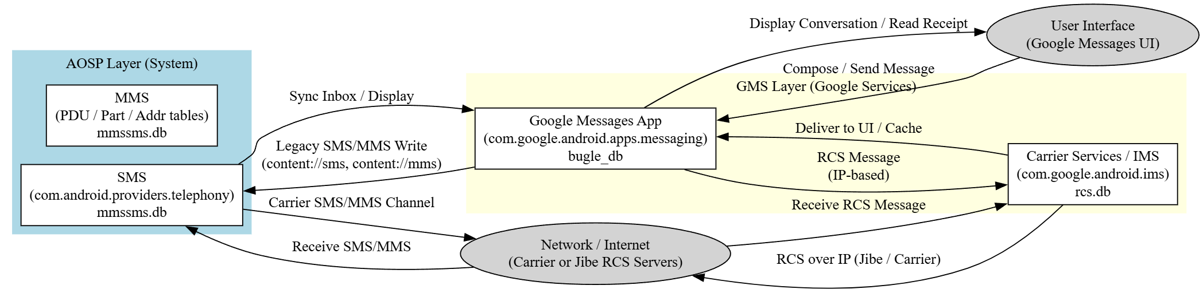
When RCS is enabled:
The Carrier Services app (com.google.android.ims) registers the phone’s RCS identity (via Google’s Jibe RCS servers or the carrier’s own IMS server).
Messages are sent over an IP connection — Wi-Fi or cellular data (4G/5G) — rather than SMS channels.
The rcs.db database logs all the transport-layer information:
rcs_message: message metadata (sender, recipient, timestamps)
rcs_session: session state
rcs_file_transfer: file URIs for sent/received media
rcs_delivery_status: delivery/read receipts
The Google Messages app (bugle_db) then displays the message to the user.
If Wi-Fi is available, the RCS stack automatically prefers it; if not, it falls back to mobile data.
Notes:
digraph MessagingFlow {
rankdir=LR;
node [shape=box, style=filled, fillcolor=lightgray];
subgraph cluster_aosp {
label = "AOSP Layer (System)";
style=filled;
color=lightblue;
sms [label="SMS\n(com.android.providers.telephony)\nmmssms.db", fillcolor=white];
mms [label="MMS\n(PDU / Part / Addr tables)\nmmssms.db", fillcolor=white];
}
subgraph cluster_gms {
label = "GMS Layer (Google Services)";
style=filled;
color=lightyellow;
bugle [label="Google Messages App\n(com.google.android.apps.messaging)\nbugle_db", fillcolor=white];
rcsdb [label="Carrier Services / IMS\n(com.google.android.ims)\nrcs.db", fillcolor=white];
}
user [shape=ellipse, label="User Interface\n(Google Messages UI)"];
network [shape=ellipse, label="Network / Internet\n(Carrier or Jibe RCS Servers)"];
// Arrows showing flow
user -> bugle [label="Compose / Send Message"];
bugle -> sms [label="Legacy SMS/MMS Write\n(content://sms, content://mms)"];
sms -> network [label="Carrier SMS/MMS Channel"];
bugle -> rcsdb [label="RCS Message\n(IP-based)"];
rcsdb -> network [label="RCS over IP (Jibe / Carrier)"];
network -> rcsdb [label="Receive RCS Message"];
network -> sms [label="Receive SMS/MMS"];
rcsdb -> bugle [label="Deliver to UI / Cache"];
sms -> bugle [label="Sync Inbox / Display"];
bugle -> user [label="Display Conversation / Read Receipt"];
}

Slide 12
Sample questions
What is the content of the message the phone received on Jan 29, 2020, at 06:20:45 pm?
Who sent the message?
Has the message been read?

Slide 13
Google Messages Directory Structure

Slide 14
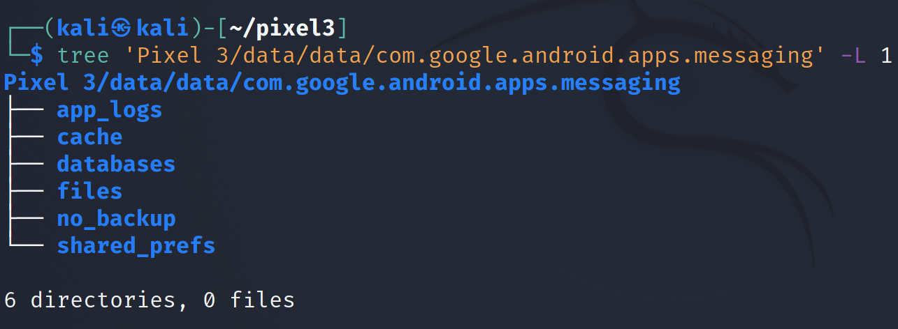
Show Google Messaging data directory structure
-L: Level
messages, contacts, etc.
downloaded attachments (e.g., images, videos), configuration files, or other app-specific data that doesn't fit into the database categories.
Notes:
Cmd: tree 'Pixel 3/data/data/com.google.android.apps.messaging' -L 1

Slide 15
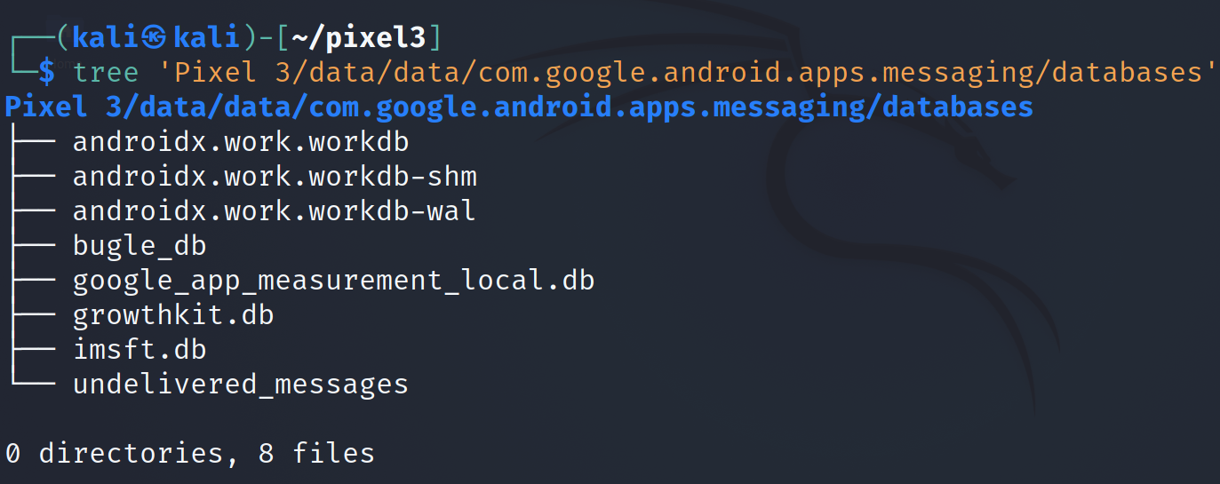
Show Google Messaging database
Notes:
Cmd: tree 'Pixel 3/data/data/com.google.android.apps.messaging/databases'

Slide 16
bugle_db

Slide 17
Purpose of bugle_db
The table aggregates and mirrors messages from multiple sources - SMS, MMS, and RCS - into one single app-level database so the user sees all chats seamlessly in one interface.
Google Messages periodically syncs:
Reads SMS/MMS from the Telephony Provider (content://sms, content://mms)
Writes RCS messages via Carrier Services (com.google.android.ims)
Displays all conversations from its own unified cache (bugle_db)
Data Source | Protocol | Backend Database | Where It’s Displayed
SMS | Cellular control channel | mmssms.db (com.android.providers.telephony) | Mirrored into bugle_db.message
MMS | Cellular WAP/MMS | mmssms.db (tables pdu, part, addr) | Mirrored into bugle_db.part / attachment
RCS | IP over Wi-Fi or data | rcs.db (com.google.android.ims) | Stored directly in bugle_db.rcs_message and linked tables
App metadata | — | Native to Google Messages | Only in bugle_db

Slide 18
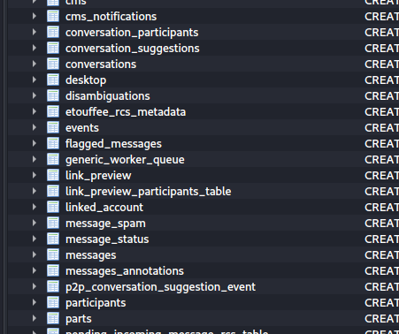
tables in bugle_db
Table contains a set of messages
Table contains messages and metadata (e.g., timestamps)
Notes:
Cmd: sqlitebrowser 'Pixel 3/data/data/com.google.android.apps.messaging/databases/bugle_db'

Slide 19
every message the user can view in Google Messages is represented in bugle_db
Table | Evidence Type | Description
messages | Text of all messages (SMS, MMS, RCS) | Unified store of message bodies, timestamps, status, thread ID
rcs_message | RCS-specific entries | Content for RCS sessions, linked to participant and conversation
participant | Contacts involved | Phone numbers, names, RCS capability
conversation | Thread metadata | Title, mute/archive flags, latest message ID
attachment / part | Media | File paths, MIME types, thumbnails
message_status / rcs_delivery_status | Receipts | Sent, delivered, read flags
draft / bugle_chat_composition | Unsent texts | Drafts or typing events
group / group_participant | RCS groups | Group membership, creation time

Slide 20
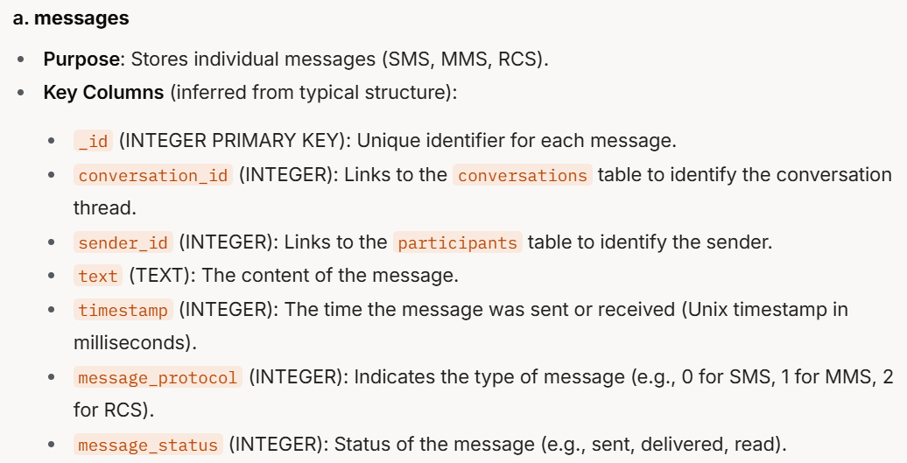
same as sms_message_uri column
Point to SMS database (mmssms.db).
Notes:
a. messages
Purpose: Stores individual messages (SMS, MMS, RCS).
Key Columns (inferred from typical structure):
_id (INTEGER PRIMARY KEY): Unique identifier for each message.
conversation_id (INTEGER): Links to the conversations table to identify the conversation thread.
sender_id (INTEGER): Links to the participants table to identify the sender.
text (TEXT): The content of the message.
timestamp (INTEGER): The time the message was sent or received (Unix timestamp in milliseconds).
message_protocol (INTEGER): Indicates the type of message (e.g., 0 for SMS, 1 for MMS, 2 for RCS).
message_status (INTEGER): Status of the message (e.g., sent, delivered, read).

Slide 21
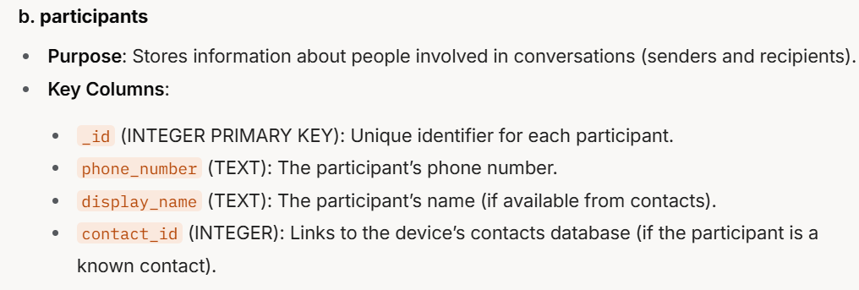
Notes:
b. participants
Purpose: Stores information about people involved in conversations (senders and recipients).
Key Columns:
_id (INTEGER PRIMARY KEY): Unique identifier for each participant.
phone_number (TEXT): The participant’s phone number.
display_name (TEXT): The participant’s name (if available from contacts).
contact_id (INTEGER): Links to the device’s contacts database (if the participant is a known contact).

Slide 22
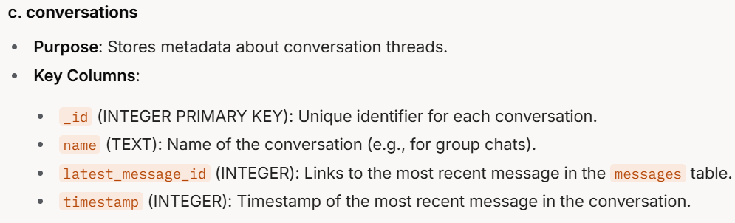
Notes:
c. conversations
Purpose: Stores metadata about conversation threads.
Key Columns:
_id (INTEGER PRIMARY KEY): Unique identifier for each conversation.
name (TEXT): Name of the conversation (e.g., for group chats).
latest_message_id (INTEGER): Links to the most recent message in the messages table.
timestamp (INTEGER): Timestamp of the most recent message in the conversation.

Slide 23
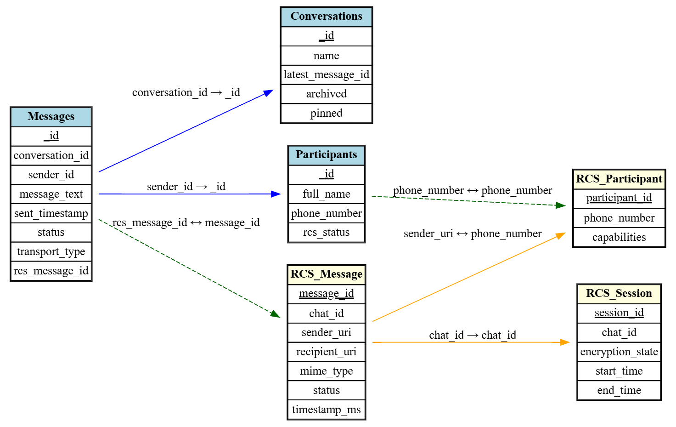
Notes:
digraph ER_Bugle_RCS_Pretty {
rankdir=LR;
node [shape=plaintext];
Messages [label=<
<TABLE BORDER="1" CELLBORDER="1" CELLSPACING="0">
<TR><TD BGCOLOR="lightblue"><B>Messages</B></TD></TR>
<TR><TD><U>_id</U></TD></TR>
<TR><TD>conversation_id</TD></TR>
<TR><TD>sender_id</TD></TR>
<TR><TD>message_text</TD></TR>
<TR><TD>sent_timestamp</TD></TR>
<TR><TD>status</TD></TR>
<TR><TD>transport_type</TD></TR>
<TR><TD>rcs_message_id</TD></TR>
</TABLE>>];
Conversations [label=<
<TABLE BORDER="1" CELLBORDER="1" CELLSPACING="0">
<TR><TD BGCOLOR="lightblue"><B>Conversations</B></TD></TR>
<TR><TD><U>_id</U></TD></TR>
<TR><TD>name</TD></TR>
<TR><TD>latest_message_id</TD></TR>
<TR><TD>archived</TD></TR>
<TR><TD>pinned</TD></TR>
</TABLE>>];
Participants [label=<
<TABLE BORDER="1" CELLBORDER="1" CELLSPACING="0">
<TR><TD BGCOLOR="lightblue"><B>Participants</B></TD></TR>
<TR><TD><U>_id</U></TD></TR>
<TR><TD>full_name</TD></TR>
<TR><TD>phone_number</TD></TR>
<TR><TD>rcs_status</TD></TR>
</TABLE>>];
RCS_Message [label=<
<TABLE BORDER="1" CELLBORDER="1" CELLSPACING="0">
<TR><TD BGCOLOR="lightyellow"><B>RCS_Message</B></TD></TR>
<TR><TD><U>message_id</U></TD></TR>
<TR><TD>chat_id</TD></TR>
<TR><TD>sender_uri</TD></TR>
<TR><TD>recipient_uri</TD></TR>
<TR><TD>mime_type</TD></TR>
<TR><TD>status</TD></TR>
<TR><TD>timestamp_ms</TD></TR>
</TABLE>>];
RCS_Participant [label=<
<TABLE BORDER="1" CELLBORDER="1" CELLSPACING="0">
<TR><TD BGCOLOR="lightyellow"><B>RCS_Participant</B></TD></TR>
<TR><TD><U>participant_id</U></TD></TR>
<TR><TD>phone_number</TD></TR>
<TR><TD>capabilities</TD></TR>
</TABLE>>];
RCS_Session [label=<
<TABLE BORDER="1" CELLBORDER="1" CELLSPACING="0">
<TR><TD BGCOLOR="lightyellow"><B>RCS_Session</B></TD></TR>
<TR><TD><U>session_id</U></TD></TR>
<TR><TD>chat_id</TD></TR>
<TR><TD>encryption_state</TD></TR>
<TR><TD>start_time</TD></TR>
<TR><TD>end_time</TD></TR>
</TABLE>>];
// Relationships
Messages -> Conversations [label="conversation_id → _id", color=blue];
Messages -> Participants [label="sender_id → _id", color=blue];
Messages -> RCS_Message [label="rcs_message_id ↔ message_id", color=darkgreen, style=dashed];
Participants -> RCS_Participant [label="phone_number ↔ phone_number", color=darkgreen, style=dashed];
RCS_Message -> RCS_Session [label="chat_id → chat_id", color=orange];
RCS_Message -> RCS_Participant [label="sender_uri ↔ phone_number", color=orange];
}

Slide 24
messages table

Slide 25
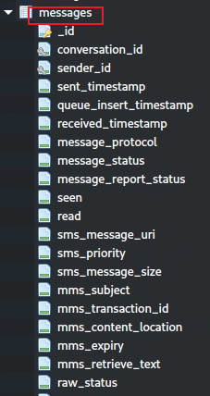
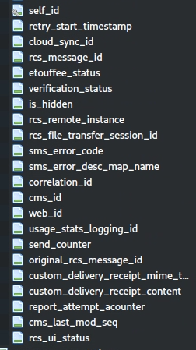
Valuable columns (1)
conversation_id: links the message to a specific conversation thread.
sender_id: Identifies the sender of the message, typically a foreign key linking to a contacts or participants table.
sent/receive_timestamp: the timestamp when the message was sent.
message_protocol: the protocol used for the message (e.g., SMS, MMS, or RCS).
message_status: tracks the delivery status of the message (e.g., sent, delivered, failed).
seen: indicating whether the user has viewed the message.
read: indicating whether the message has been marked as read. Similar to seen, but often tied to RCS read receipts

Slide 26
Valuable columns (2)
ms_message_uri (for SMS): the URI of the SMS message in the Android Telephony Provider (e.g., content://sms/123 in mmssms.db).
mms_subject (for MMS): the subject line of an MMS message, if applicable.
mms_content_location (for MMS): the URL or location where the MMS content (e.g., images, videos) can be downloaded from the carrier’s server
rcs_message_id (for RCS): identifier for RCS messages, used to track messages in RCS systems.
etouffee_status (for RCS): Indicates the encryption status of an RCS message (likely related to "Etouffee," a codename for RCS end-to-end encryption in Google Messages)
raw_status: the raw status of the message as reported by the underlying system (e.g., carrier or RCS server).

Slide 27
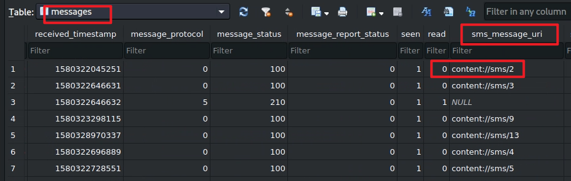
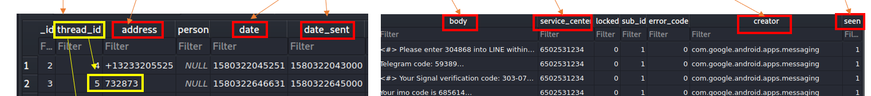

messages table content
Point to sms table in mmssms.db of com.android.provider.telephony.

Slide 28
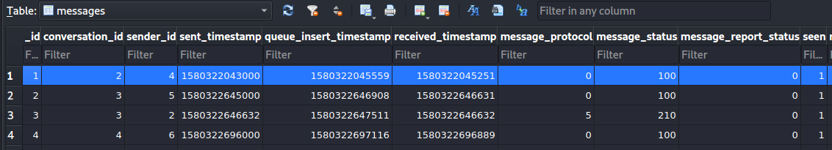
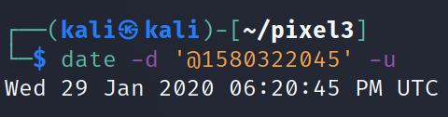
The timestamp of Message received

Slide 29
Find conversation id
conversation_id=2

Slide 30
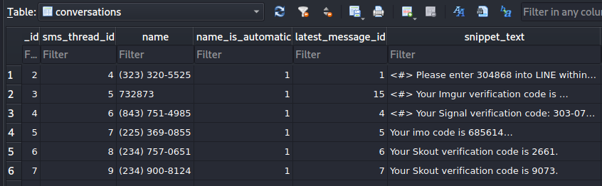
name of the conversation
Solution: message content sent on Jan 29, 2020 at 06:20:43 pm
Find _id=2 in conversations table

Slide 31
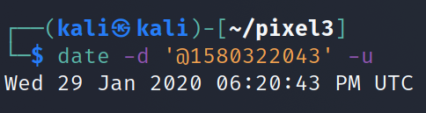
When was the message sent by the other person?
The timestamp of Message sent

Slide 32
link to participate table
Who sent the message?

Slide 33
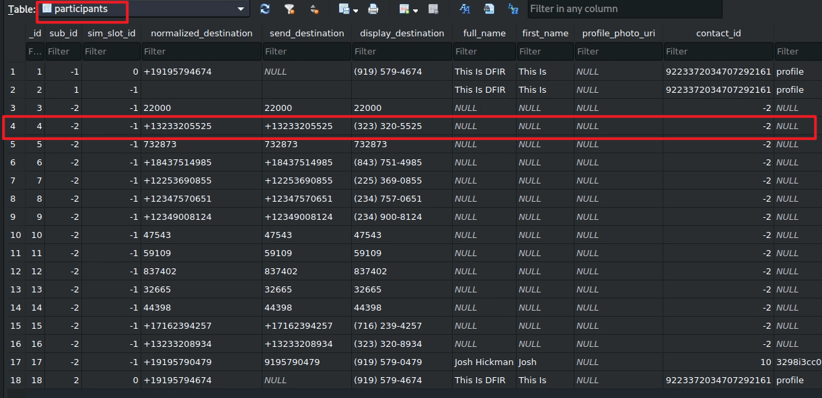
international format
user-friendly format
-2: no contact match

Slide 34
Seen: read flag
0: False, message has not been seen
1: True means its has been seen
Has the message been read?

Slide 35
To summarize
Understand the application
Look at the application directories
Go to the "databases" directory
Open bugle_db
Explore these tables: messages, conversations, participant
Fetch the information needed from these tables

